Slide 1
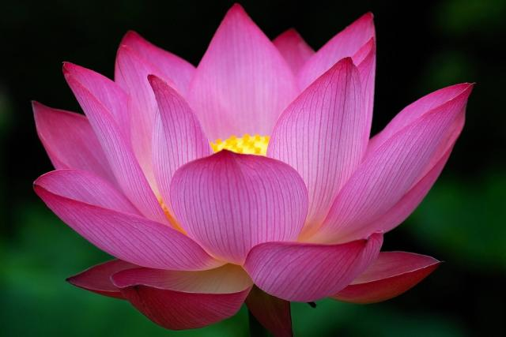
WEL COME
.

Slide 2
INTRODUCTION
MOHAMMAD ABULHOSSAIN
ASSISTANT TEACHER
Ghagotia Chala High School
Kapasia, Gazipur
Subject-English 1st paper
Class-8
Unit-06
Lesson-02
Date-18-2-2014

Slide 3
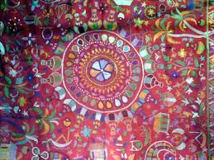
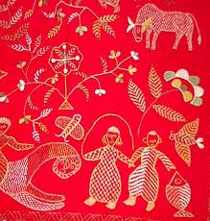
‘
.
‘

Slide 4
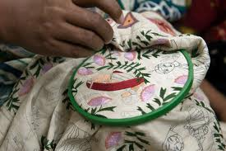
.
.
.

Slide 5
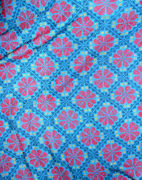
presentation
After showing the picture T wii tell the ss
What is it called?
Where is it specially made.

Slide 6
Name of the lesson
When the ss will guess the idea about the lesson. In the mean time T will announcement lesson’s name .todays lesson is “NAKSHI KANTHA” page no-64

Slide 7
LEARNING OUTCOMES
After reading the lesson the ss will able to learn………………..
Ss will able to learn nakshi kantha and and ordinary kantha.
Ss wil able to describe nakshi kantha
Ss will able to learn pattern of nakshi kantha.
To emphasis the demand of nakshi kantha.

Slide 8
Pair work
Read the text silently and and answers the questions.
What do we do with nakshi kantha.
What kind of people made it.

Slide 9
GROUP WORK
1.How many materials are needed for nakshi kantha?
2.What is the pattern of nakshi kantha?

Slide 10
EVALUATION
How are the demand of nakshi kantha?
Why it is indigenous Bangladesh and India?

Slide 11
HOME WORK
Write a paragraph describing how the nakshi kantha is made .start like this : old or new cloth and coloured thread are needed ……..

Slide 12

THANK YOU
.

